Slide 1
Intro to PeachTree Create a Company General Journal Transaction
Unit 3
Peachtree Tutorial

Slide 2
Table of Contents
Slide 3 - Open Software
Slide 4 - Create a New Company
Slide 12 - Clean Up Your Screen
Slide 14 - Restore a Company (assignment)
Slide 21 - Rename Company
Slide 23 - Back Up Company (Save)
Slide 27 – Software Terminology
Slide 28 - General Journal Entry

Slide 3
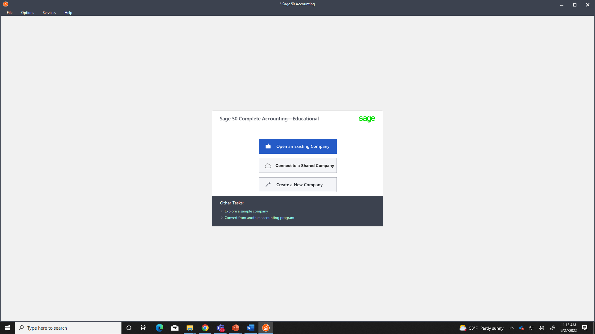
Open Software
Desktop
Sage 50 Accounting 2022
Click - Create a New Company

Slide 4
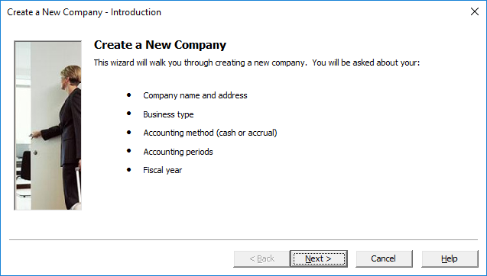
Create a New Company
Click - Next

Slide 5
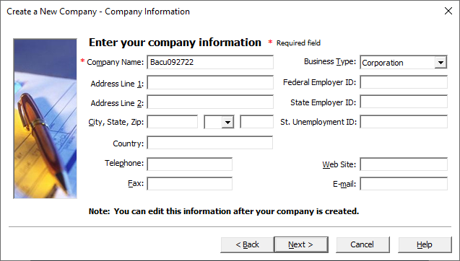
Create a New Company
Type in “LastName” and “today’s date”
Example “Bacu092722”
Click - Next

Slide 6
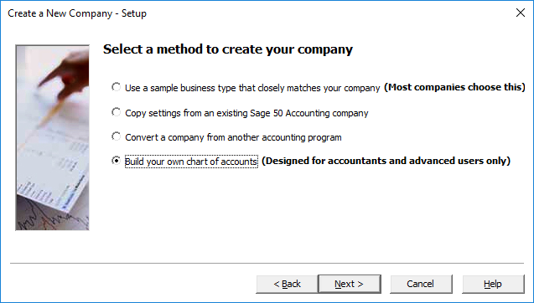
Create a New Company
Change default setting to
Build your own chart of accounts (Designed for accountants and advanced users only)
Click - Next

Slide 7
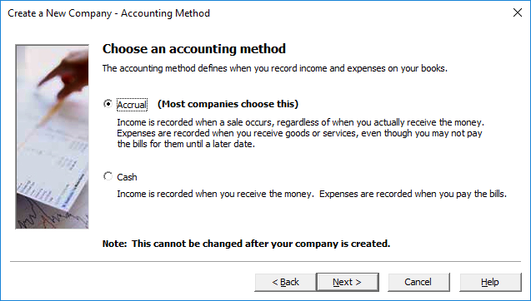
Create a New Company
Click - Next

Slide 8
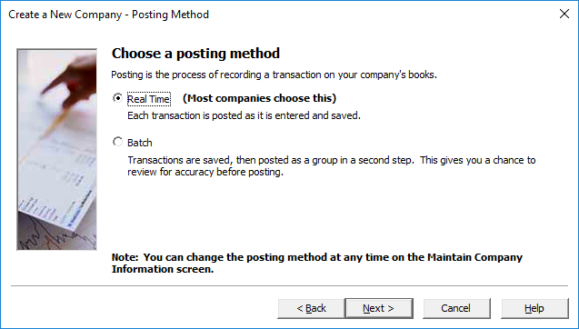
Create a New Company
Click - Next

Slide 9
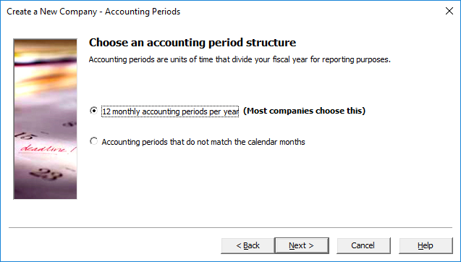
Create a New Company
Click - Next

Slide 10
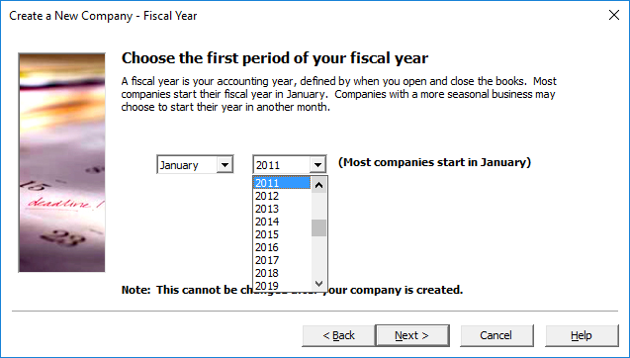
Create a New Company
Change the year to “2011”
Click - Next

Slide 11
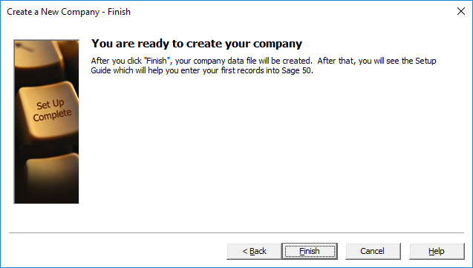
Create a New Company
Click - Finish

Slide 12
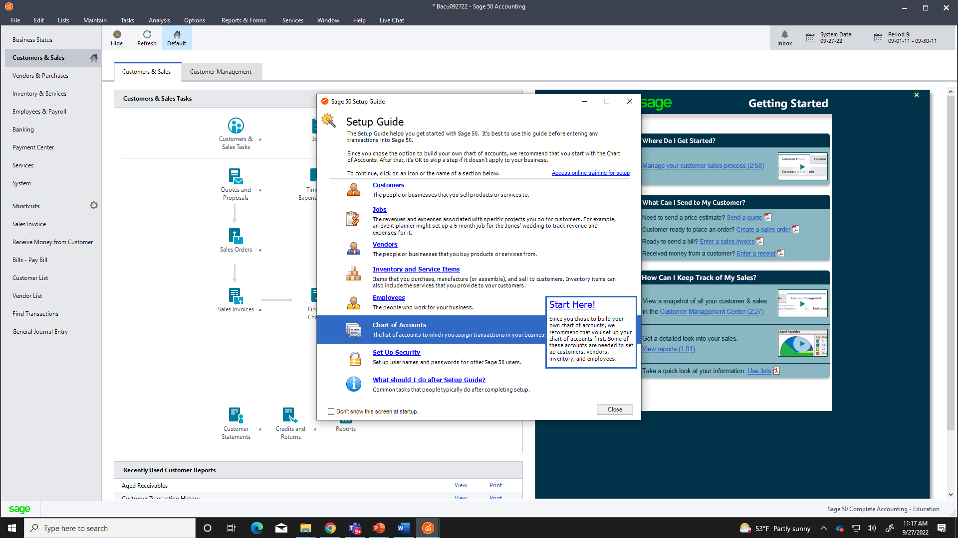
Clean Up Your Screen
Click lower left box
Click - Close

Slide 13
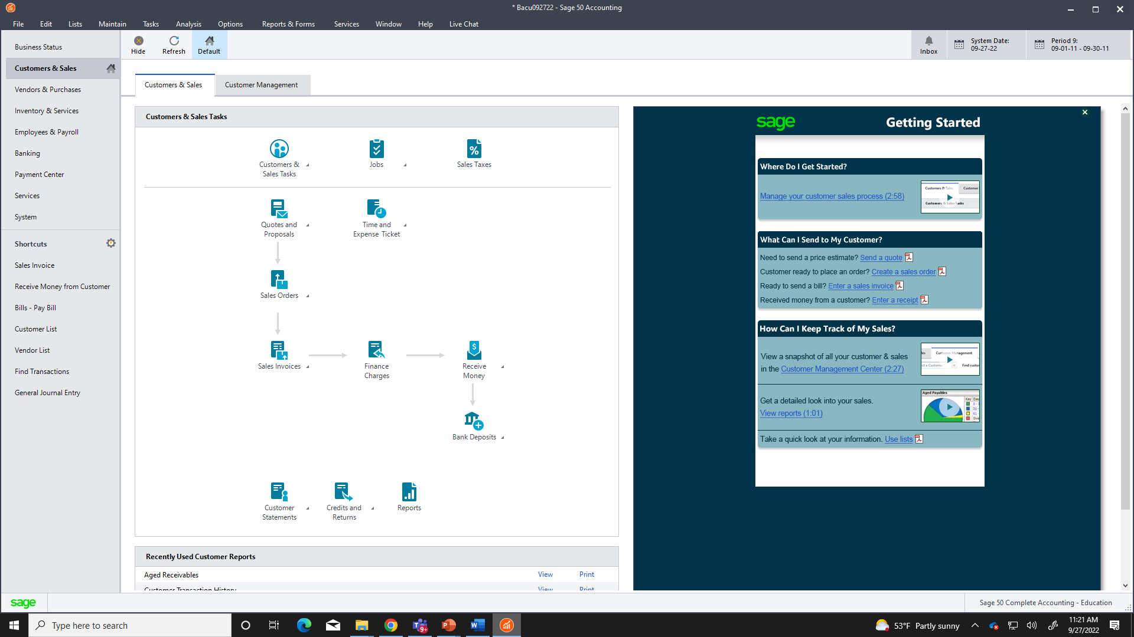
Clean Up Your Screen
Click top right corner

Slide 14
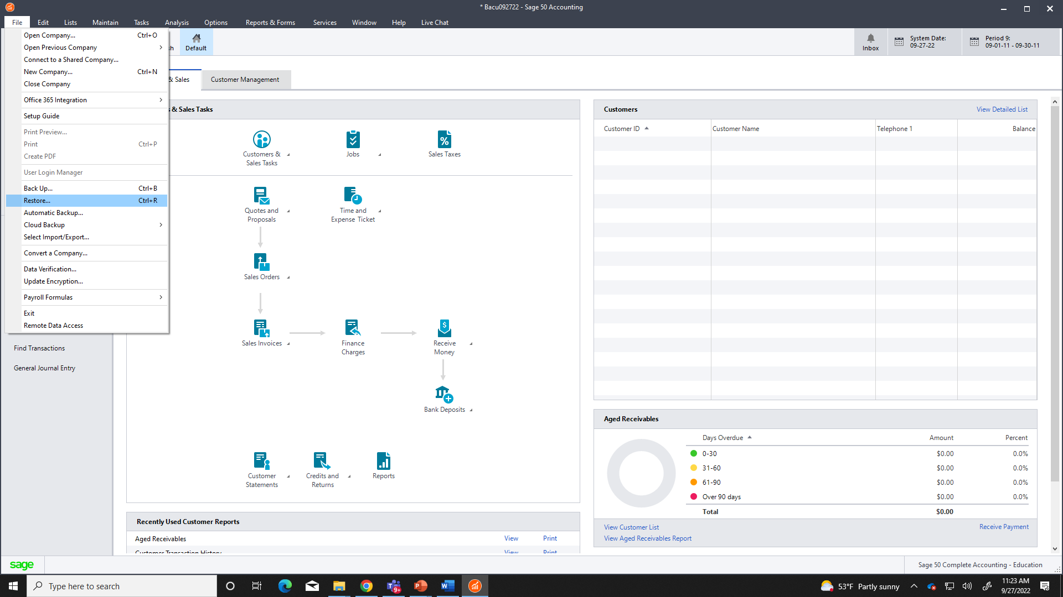
Restore a Company (assignment)
File – Restore

Slide 15
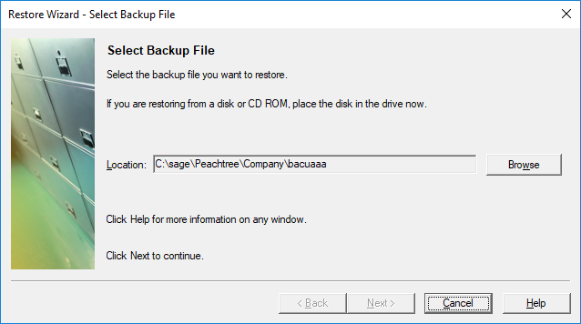
Restore a Company (assignment)
Click - Browse

Slide 16
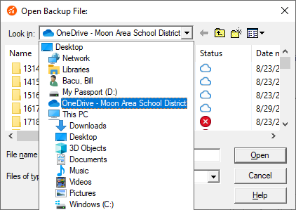
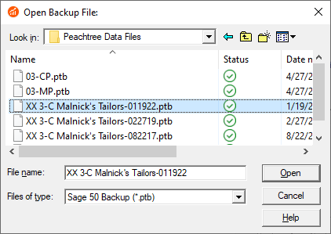
Restore a Company (assignment)
Download from TEAMS and Save in OneDrive
OneDrive / Accounting / Chapter
(Chapter currently working in)
Select the assignment
Click - Open

Slide 17
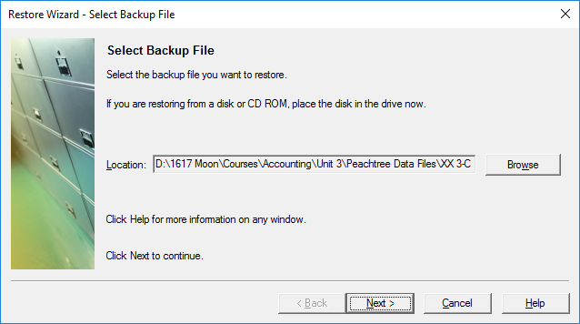
Restore a Company (assignment)
Click - Next

Slide 18
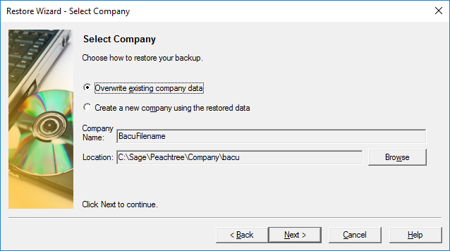
Restore a Company (assignment)
Click - Next

Slide 19
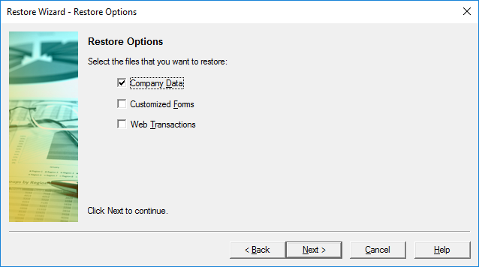
Restore a Company (assignment)
Click - Next

Slide 20
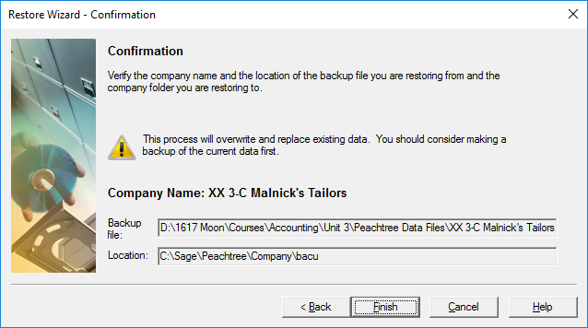
Restore a Company (assignment)
Click - Finish

Slide 21
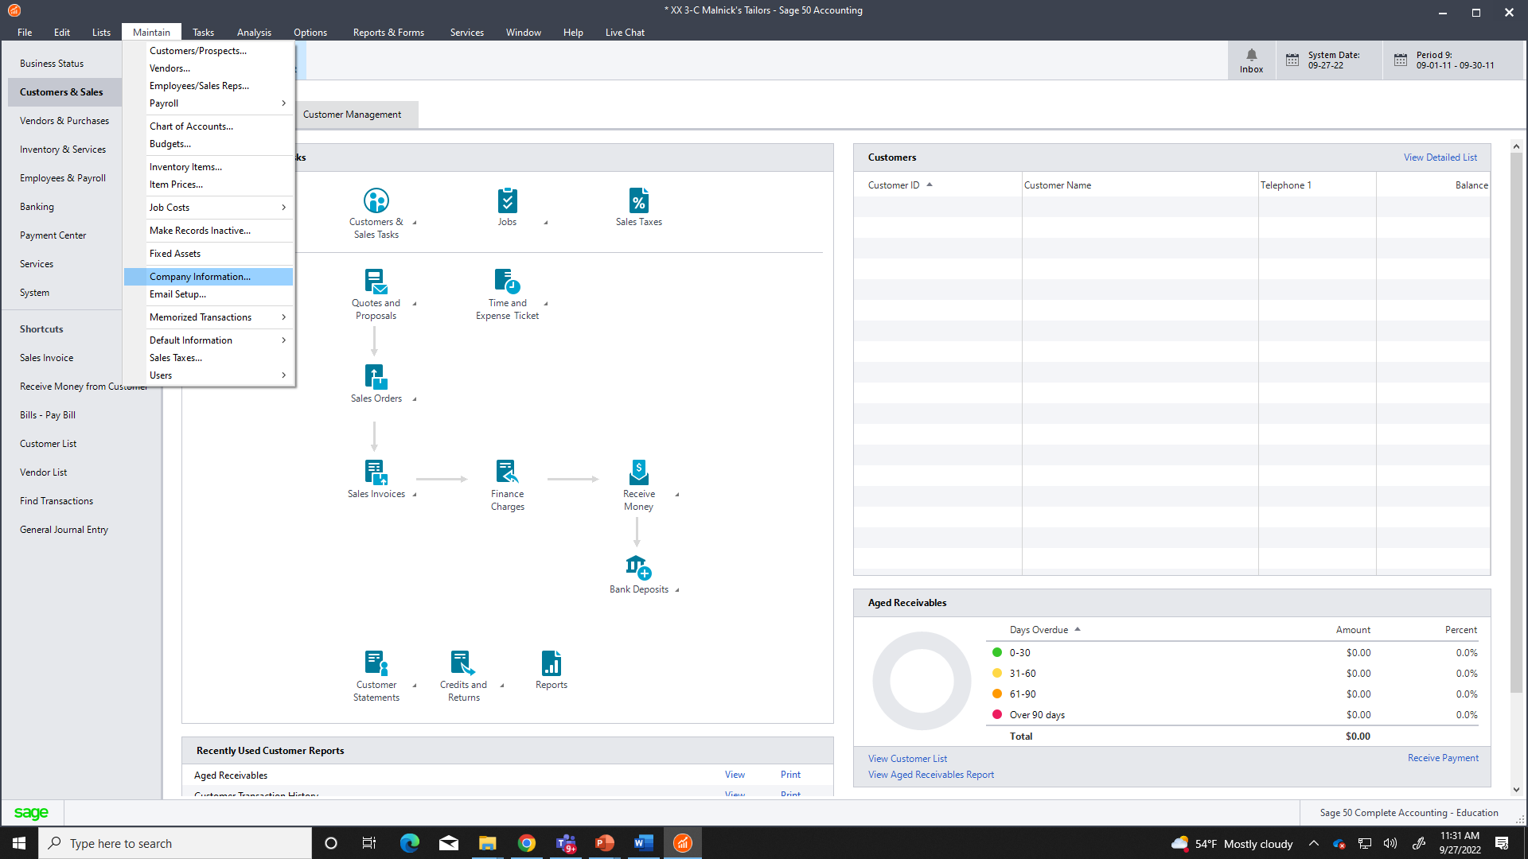
Rename Company
Maintain – Company Information

Slide 22
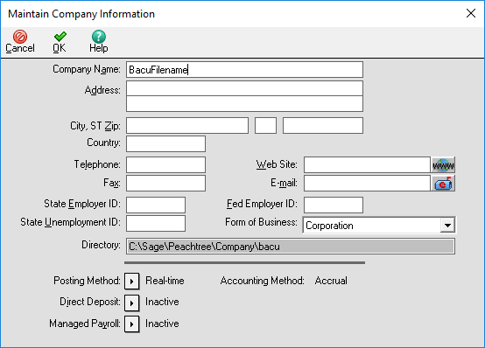
Rename Company
Type your “Lastname” and Assignment Name
Click - OK

Slide 23
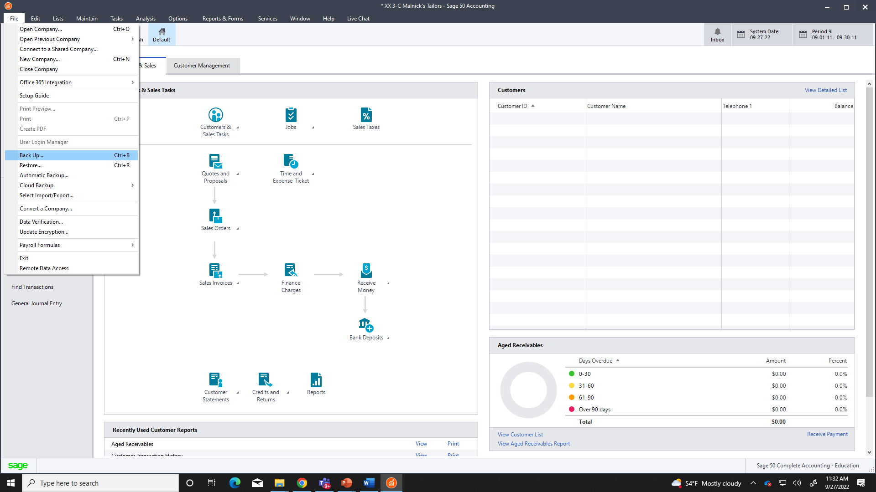
Back Up Company (Save)
Maintain – Back Up

Slide 24
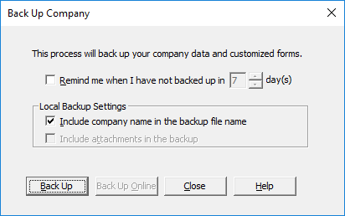
Back Up Company (Save)
Click - Back Up

Slide 25
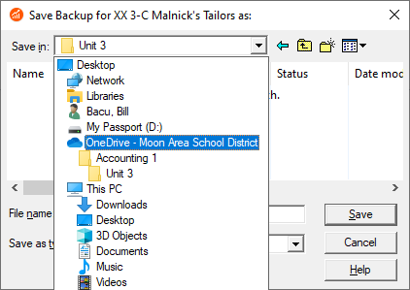
Back Up Company (Save)
Select a location on your OneDrive
Accounting 1 / Chapter (currently working in)
Click - Save

Slide 26
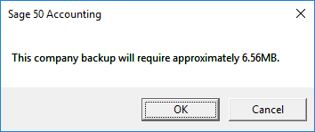
Back Up Company (Save)
Click - OK

Slide 27
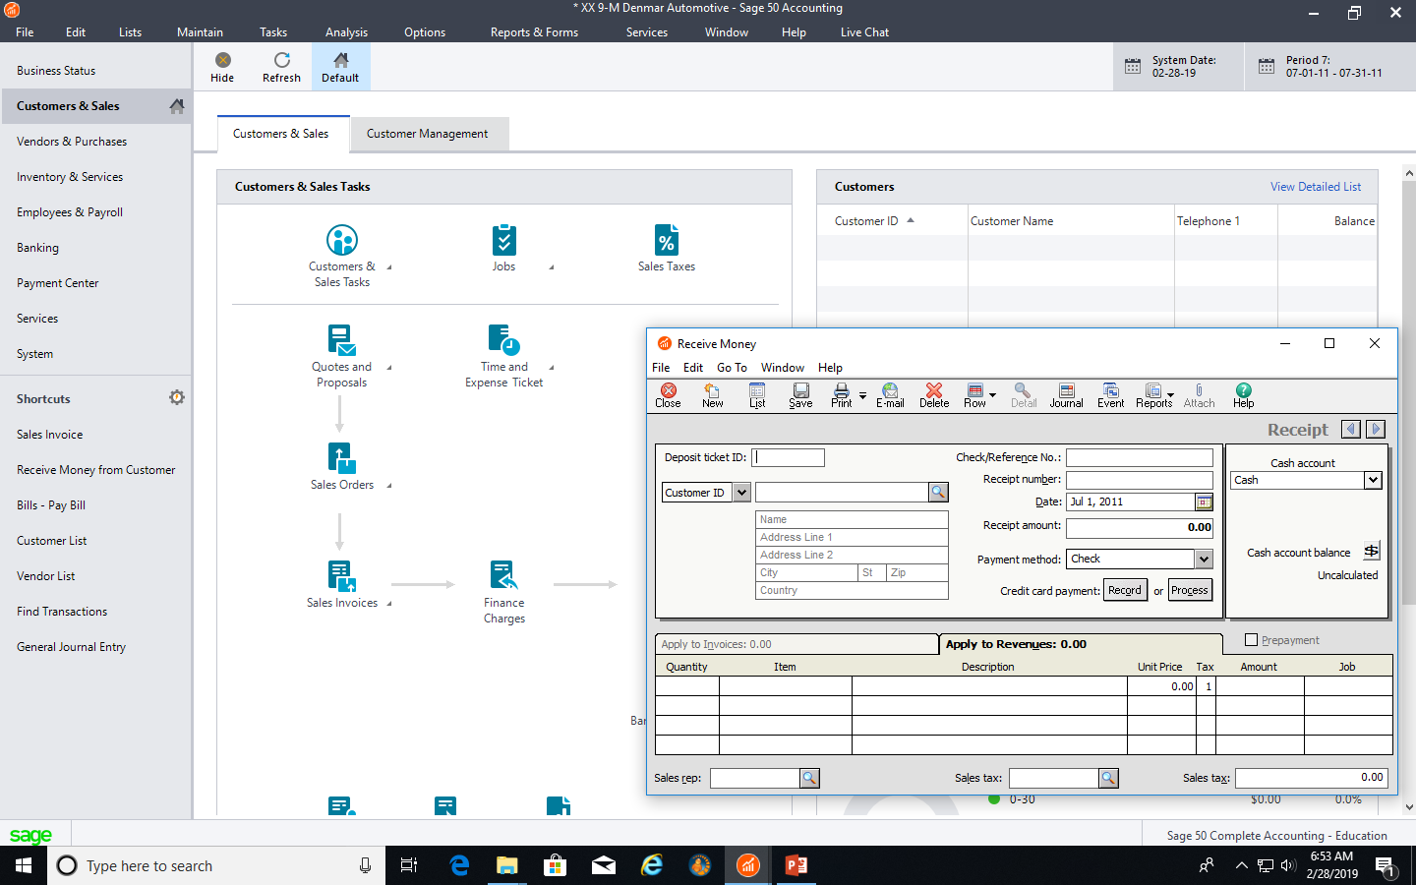
Software Terminology
TABS
ICONS
WINDOW

Slide 28
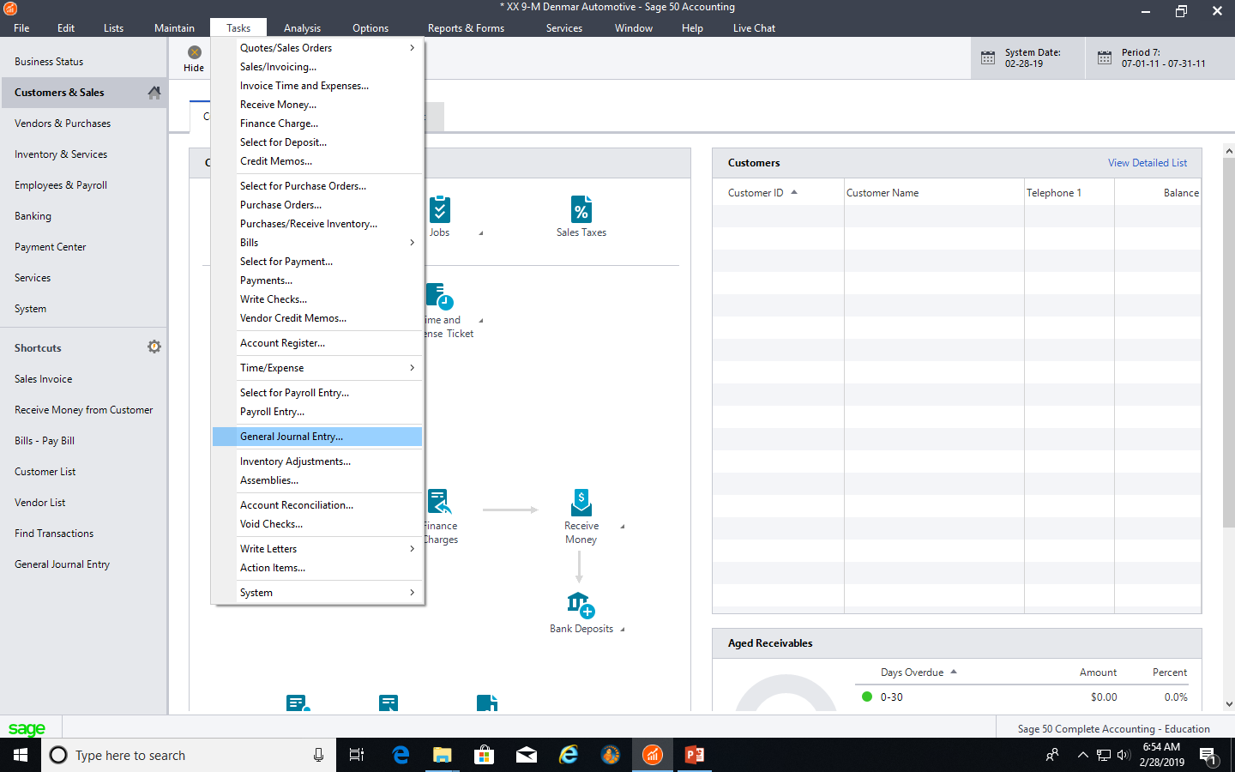
General Journal Entry
Task – General Journal Entry

Slide 29
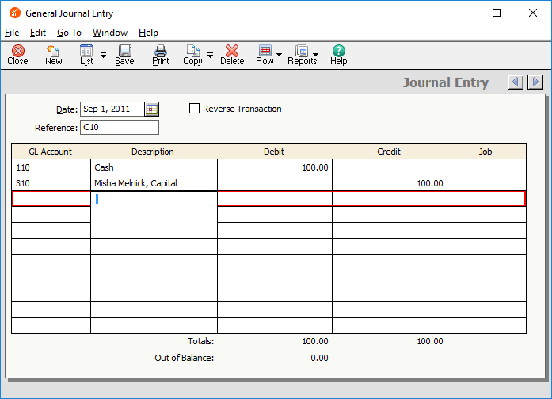
General Journal Entry
Date
Reference (Source Document)
Debit Account (Use Drop Down Menu)
Debit Description (Must Type Name)
Debit Amount
Credit Account (Use Drop Down Menu)
Credit Description (Must Type Name)
Credit Amount
Complete Items in Red

Slide 30
General Journal Entry
Click - Save

